Slide 1

assessPool: a poolseq pipeline
Data Skills for Biology Workshop
HIMB May 3rd, 2024
Evan B Freel | Emily E Conklin | Maddie Emms

Slide 2

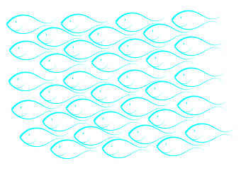
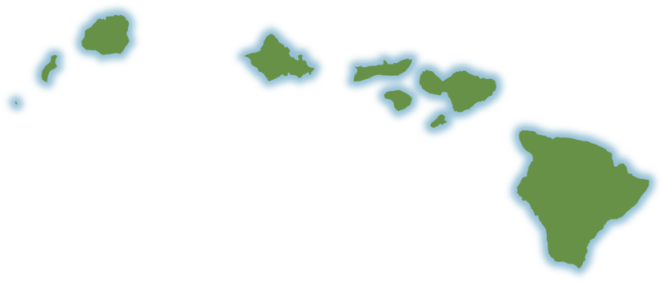
Population Genomics
Study of genomic variation
How and why alleles across the genome differ in populations
Exchange of genetic material between populations via migrants and reproduction
Notes:
With access to additional data, we can broaden our approach and look at patterns of variation across the genome
We can ask the same questions population genetics aims to explain, but bring more power to analyses

Slide 3
Reduced representation genome sequencing
Andrews et al. 2016
Notes:
While sequencing complete genomes for each individual in an analysis would be fantastic we still aren’t quite there yet.
Instead we can take scaled back approaches using reduced representation sequencing methods that let you survey many regions of the genome
There are a lot of flavors of these approaches, but for today we will be talking about ezRAD

Slide 4
Reduced representation genome sequencing
Low-cost
Thousands of markers
Any species
Andrews et al. 2016
Notes:
These approaches are relatively low cost, allows genotyping at thousands of markers, and can be applied to any species
which is important for marine species, which often are lacking genomic resources

Slide 5
Pooled sequencing (pool-seq)
Maui
Oʻahu
Hawaiʻi
Notes:
If your question is focused at large population scale, you can further drive project costs down dramatically by pooling the DNA from multiple individuals in a population prior to sequencing.
Say you’re interested in if there’s any population structure in a fish species at a few different islands.
To have statistical power in those analyses, you need a sample that includes the diversity from across the population.
You can’t just sequence one individual from each location.

Slide 6

Pool-seq
Maui
Oʻahu
Cost effective for population vs individual-level data
Hawaiʻi
Notes:
So you can either sequence many individuals or you can combine DNA from many individuals and then just sequence one sample that represents the genetic diversity within that population.
In this case, if you need 50 individ from ea/ location - you would then be sequencing 150 fish which would be very expensive,
or if you just want to know the differences in populations, you can sequence one representative sample in each population.

Slide 7
Pool-seq
Maui
Oʻahu
Cost effective for population vs individual-level data
Hawaiʻi
Notes:
Making this quite cost effective for generating population vs individual-level data

Slide 8
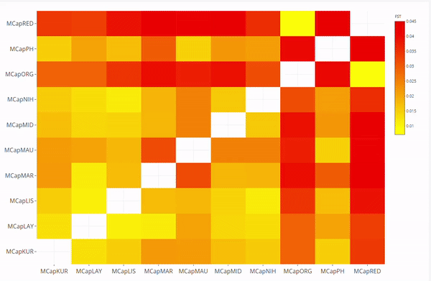
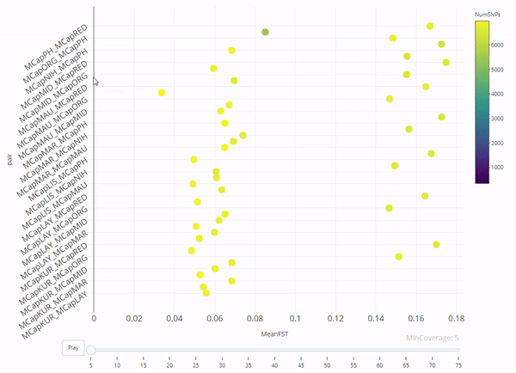

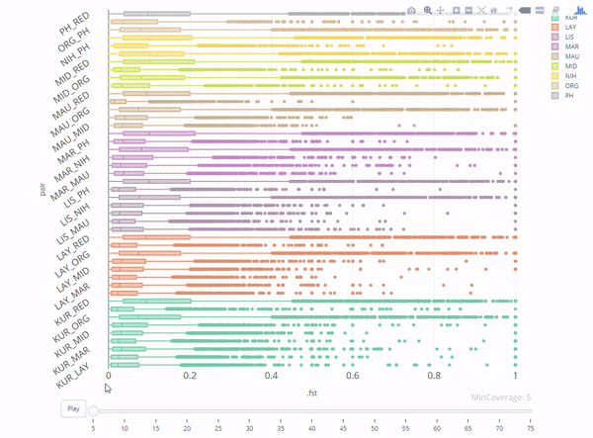
Input
Notes:
I’d be happy to get into the nitty gritty with anyone at the pau hana, but I’d like to broadly walk you through assessPool
Given the analytical hurdles poolseq that several of us in the ToBo lab faced with pooled datasets, I spearheaded a group alongside the amazing Emily Conklin, to develop a bioinformatic pipeline to handle these data
Our goal was to create an automated workflow that produced informative plots to help people understand their data using interactive visualizations to really see how filtering and parameter choices impact their results, improving general data literacy

Slide 9
Input
Notes:
Before talking about assesspool however, we have to do a quick runthrough of how to produce input data for the pipeline

Slide 10
assessPool: Pool-seq Pipeline
Rstudio
Quality control
SNP Filtering
Notes:
In an effort to keep our workflow accessible, everything in assessPool is executed in an open-source and extremely commonly used statistical software environment in Rstudio which uses the R language
First we streamline quality control and data filtering

Slide 11
assessPool: Pool-seq Pipeline
Rstudio
Quality control
SNP Filtering
Genetic differentiation
Notes:
Then calculate genetic differentiation between every pool, at every SNP

Slide 12
assessPool: Pool-seq Pipeline
Rstudio
Quality control
SNP Filtering
Genetic differentiation
Interactive graphics to visualize parameter selection
Interactive outputs for data exploration
Notes:
And outputs interactive plots along the way to visualize how filtering and parameter decisions impact results

Slide 13
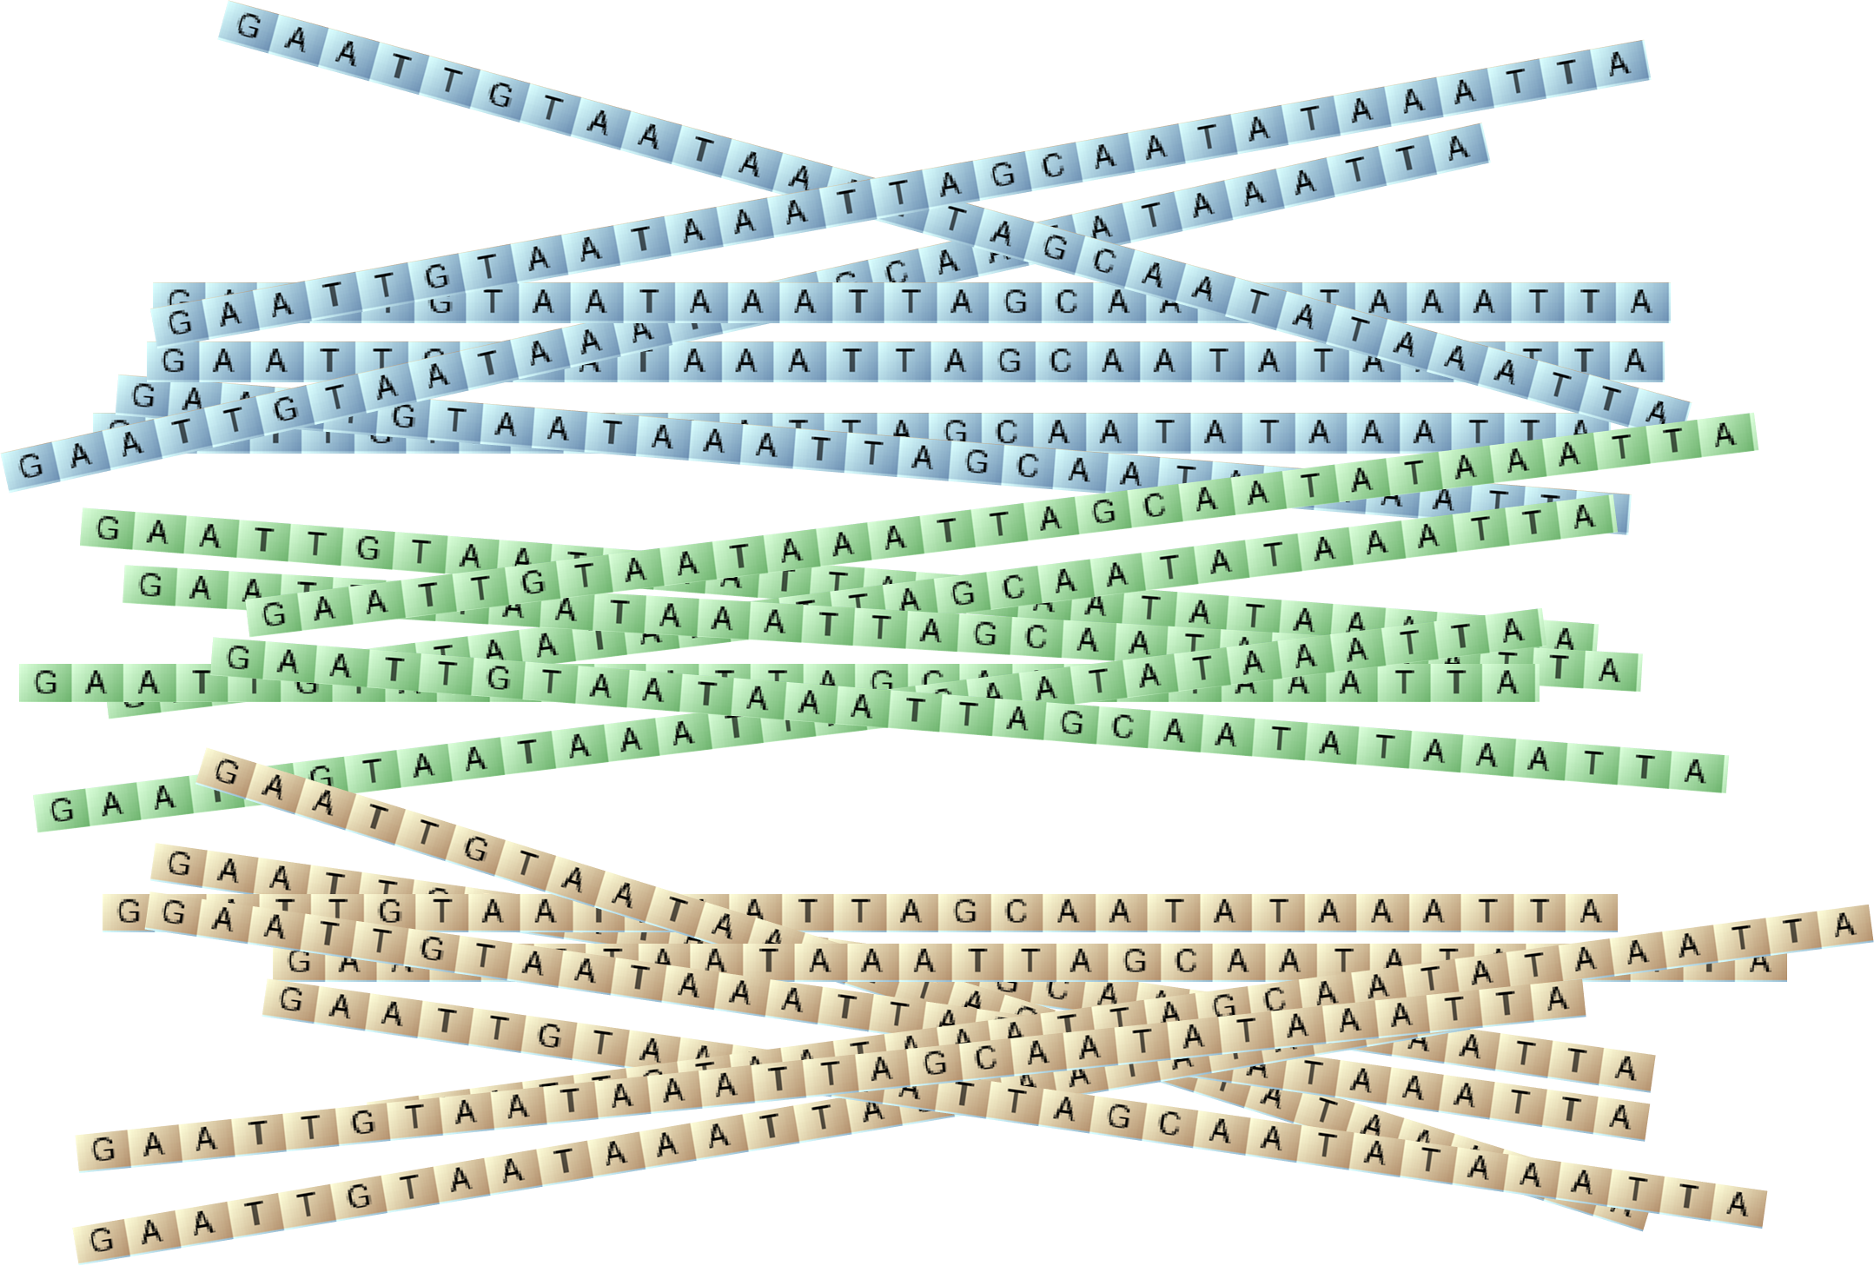





Bioinformatic Workflow
DNA sequences
Trimming
Assembly
Mapping
Variant Calling
assessPool
Input
TrimGalore!
SPAdes
bwa-mem
Freebayes
Notes:
To do this I’ve developed a workflow modeled from the program dDocent, with modifications to handle pooled data
I have also added optional multithreading support to nearly every step, which essentially allows us to run everything faster by chopping up datasets into smaller pieces, and running them simultaneously

Slide 14
Bioinformatic Workflow
DNA sequences
Trimming
Assembly
Mapping
Variant Calling
assessPool
Input
TrimGalore!
SPAdes
bwa-mem
Freebayes
Notes:
First we take all of our reads and trim off unnecessary bits

Slide 15
Bioinformatic Workflow
DNA sequences
sample_1.fq.gz sample_2.fq.gz
sample_3.fq.gz
sample_4.fq.gz
sample_5.fq.gz
de_novo_reference.fasta
Trimming
Assembly
Mapping
Variant Calling
assessPool
Input
TrimGalore!
SPAdes
bwa-mem
Freebayes
Notes:
We then assemble the reads to create a reference to use in leiu of complete geneomes, which understudied species typically lack
######
Then we use SPAdes to assemble what is called a de novo assembled genome.
Essentially this is a map of shared regions between your pools that you can use when a complete genome isn’t available for your study species,
which is often the case with marine species – particularly invertebrates.
The SPAdes assembler performed remarkably well with pooled data – often recovering entire mitochondrial genomes

Slide 16
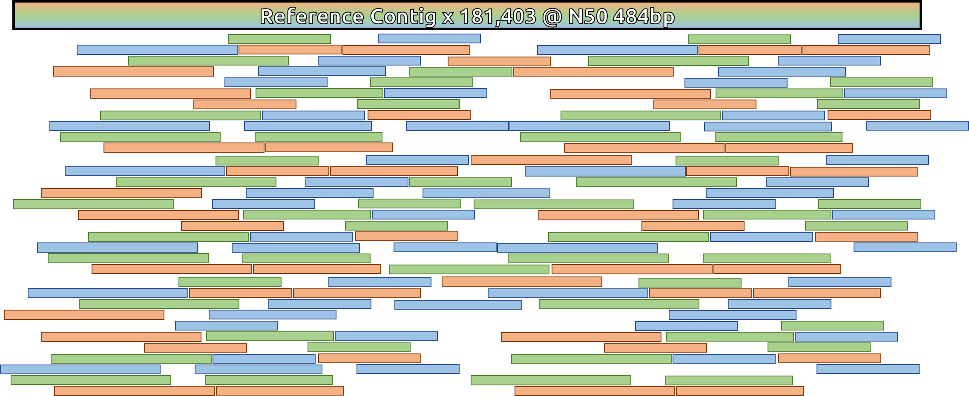
Bioinformatics: Assembly
de novo Assembly
Contiguous Region (contig)
300bp PE reads
~3M reads/pool
Notes:
Then we use SPAdes to assemble what is called a de novo assembled genome.
Essentially this is a map of shared regions between your pools that you can use when a complete genome isn’t available for your study species,
which is often the case with marine species – particularly invertebrates.
The SPAdes assembler performed remarkably well with pooled data – often recovering entire mitochondrial genomes

Slide 17
Bioinformatic Workflow
de_novo_reference.fasta
sample_1.bam sample_2.bam
sample_3.bam
sample_4.bam
sample_5.bam
sample_1.fq.gz sample_2.fq.gz
sample_3.fq.gz
sample_4.fq.gz
sample_5.fq.gz
Trimming
Assembly
Mapping
Variant Calling
assessPool
Input
TrimGalore!
SPAdes
bwa-mem
Freebayes
Notes:
We can then map everything to our reference to assign coordinates for where our reads belong on that reference
###
We can then take all of our sequences and map them back to our de novo assembled genome so we essentially have coordinates for each sequence (contig 1, position 200 or something)

Slide 18
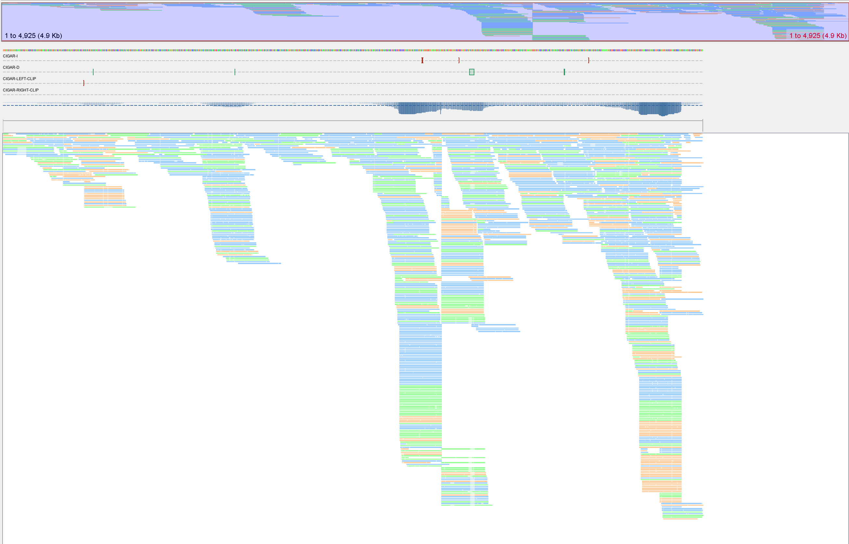

Bioinformatics: Mapping
Read Mapping
lh3/bwa
s
Notes:
We can then take all of our sequences and map them back to our de novo assembled genome so we essentially have coordinates for each sequence (contig 1, position 200 or something)

Slide 19
Bioinformatic Workflow
SNP: Single Nucleotide Polymorphism
Trimming
Assembly
Mapping
Variant Calling
assessPool
Input
TrimGalore!
SPAdes
bwa-mem
Freebayes
Notes:
And then we can finally identify variants, in our case SNPs or single nucleotide polymorphisms, which are single base pair changes to the DNA sequence
You’ll hear me use the words SNPs and loci often. Loci, and its singular locus, is a term used to refer to a specific area of the genome.
This can be a region of a gene or a single base pair so you’ll hear me refer to SNP loci.
####
We then use freebayes to identify variants, in our case, single nucleotide polymorphisms (or SNPs), which is a single base pair change in the DNA sequence
You’ll hear me use the word SNP and loci often. Loci, and its singular locus, is a term used to refer to a specific area of the genome.
This can be a region of a gene or a single base pair so you’ll hear me refer to SNP loci.

Slide 20
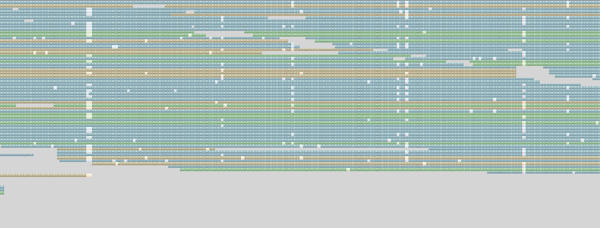
Bioinformatics: Variant Calling
SNP Calling
ekg/freebayes
SNP: Single Nucleotide Polymorphism
Notes:
We then use freebayes to identify single nucleotide polymorphisms (or SNPs), which is a single base pair change in the DNA sequence
You’ll hear me use the word SNP a lot

Slide 21
Bioinformatic Workflow
reference.fasta
SNPs.vcf
sample_1.bam sample_2.bam
sample_3.bam
sample_4.bam
sample_5.bam
Trimming
Assembly
Mapping
Variant Calling
assessPool
Input
TrimGalore!
SPAdes
bwa-mem
Freebayes
Notes:
And then we can finally identify variants, in our case SNPs or single nucleotide polymorphisms, which are single base pair changes to the DNA sequence
You’ll hear me use the words SNPs and loci often. Loci, and its singular locus, is a term used to refer to a specific area of the genome.
This can be a region of a gene or a single base pair so you’ll hear me refer to SNP loci.
####
We then use freebayes to identify variants, in our case, single nucleotide polymorphisms (or SNPs), which is a single base pair change in the DNA sequence
You’ll hear me use the word SNP and loci often. Loci, and its singular locus, is a term used to refer to a specific area of the genome.
This can be a region of a gene or a single base pair so you’ll hear me refer to SNP loci.

Slide 22
Bioinformatic Workflow
Trimming
Assembly
Mapping
Variant Calling
assessPool
Input
TrimGalore!
SPAdes
bwa-mem
Freebayes
Notes:
After variant calling we have our SNP loci in a file

Slide 23
assessPool
Input
Notes:
And we can then take that into assessPool

Slide 24


SNP Filtering
vcftools and vcflib
Multithreading support
Notes:
We start out by filter our data to minimize erroneous SNP calls to remove data that does not meet our quality standards
AssessPool allows 16 filtering options (5 vcftools;11 vcflib)
Runs each independently for accurate losses per filter

Slide 25
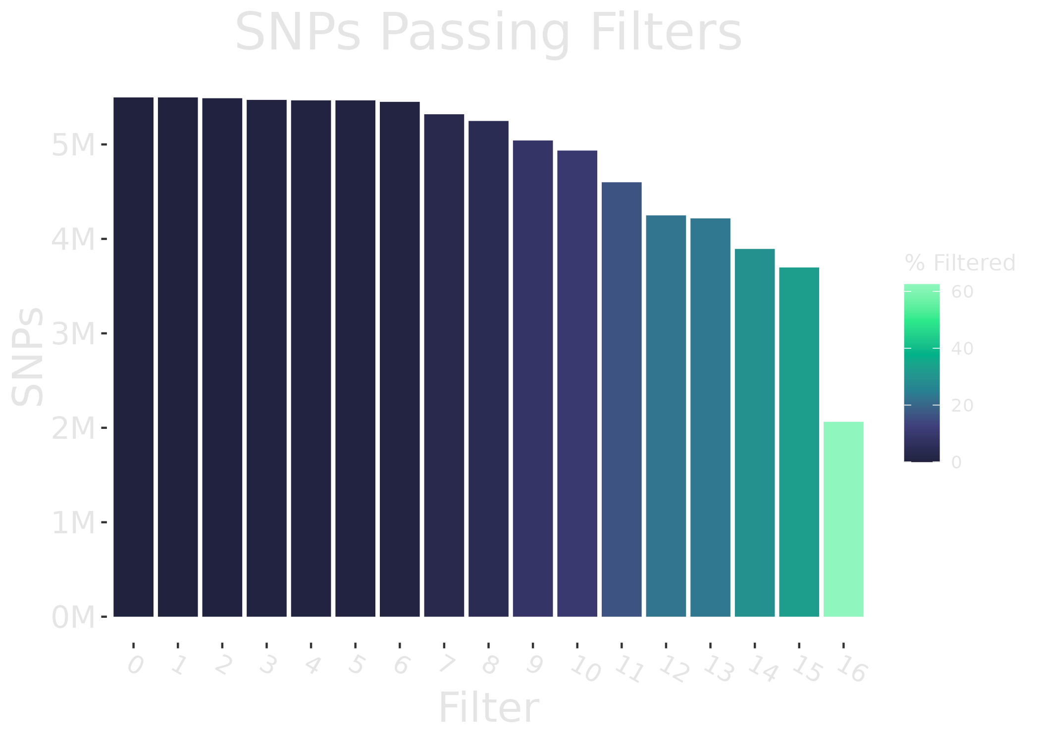
SNP Filtering
vcftools and vcflib
Multithreading support
Notes:
You then get a plot like this simplified version here, which just let’s you know how many SNPs passed each step, which lets you see where filtering may be too stringent, and it lets you see if there are any concerning patters in your data that should be addressed upstream
#
Increase plot labels

Slide 26

Filtered VCF
Pool
Locus
Notes:
We can then take this filtered input file, which contains information about each pool, distinguished by color here, and each locus by shape

Slide 27
Filtered VCF
Pool
Locus
Notes:
We can then split it up inti pairwise comparisons of our pools. For instance in this top section, we would be comparing the yellow and green pools at every spot survyeyed

Slide 28
PoPoolation2 {poolfstat}
Pool
Locus
Notes:
assessPool the creates the scripts necessary to run both the PoPoolation2 perl program and R package poolfstat.

Slide 29
PoPoolation2 {poolfstat}
}
F_{ST}
Filtered VCF
Pool
}
F_{ST}
Locus
}
F_{ST}
Notes:
Both of these then output a parameter we can use to estimate genetic differentiation, called Fst

Slide 30
Fixation Index (F_{ST})
Population 1
Population 2
Notes:
Fst is one way we can estimate population differentiation due to genetic structure,
It ranges from about zero, up to one
Say you have two populations each with two smaller groups
Hs probability two alleles sampled from the same subpopulation are different
Ht probability two alleles from different subpopulations are different

Slide 31
Fixation Index (F_{ST})
Population 1
Population 2
1A
1B
2A
2B
F_{ST} = 0
F_{ST} = 1
No differentiation
Differentiation
Notes:
If an individual can have a purple or white allele, and the smaller groups are equally mixed with purple AND white alleles, Fst is 0 and we cant detect differences
If the small groups only have purple OR white alleles, as in the example on the right, we’d pick up differentiation and would see a high Fst value
Hs probability two alleles sampled from the same subpopulation are different
Ht probability two alleles from different subpopulations are different

Slide 32
Fixation Index (F_{ST})
Population 1
Population 2
1A
1B
2A
2B
F_{ST} = 0
F_{ST} = 1
No differentiation
Differentiation
Notes:
With no differentiation on the left, we can infer they are exhanging alleles
and on the right we can infer some barrier or process preventing genetic exchange
This is an oversimplificaiton, but the main takeaway is that differentiation increases with Fst
Hs probability two alleles sampled from the same subpopulation are different
Ht probability two alleles from different subpopulations are different

Slide 33
Fixation Index
Population 1
A
B
Probability of drawing different alleles
Notes:
Hs probability two alleles sampled from the same subpopulation are different
Ht probability two alleles from different subpopulations are different

Slide 34
Fixation Index
Population 1
A
B
Probability of drawing different alleles
Notes:
Hs probability two alleles sampled from the same subpopulation are different
Ht probability two alleles from different subpopulations are different

Slide 35
Fixation Index
Population 1
A
B
H_{S} = 0
Probability of drawing different alleles
Notes:
Hs probability two alleles sampled from the same subpopulation are different
Ht probability two alleles from different subpopulations are different

Slide 36
Fixation Index
Population 1
A
B
H_{S} = 0
H_{T} = 1
Probability of drawing different alleles
Notes:
Sample two alleles. Probability they are different.
From the same subpopulation = 0
From different subpopulations = 1
Hs probability two alleles sampled from the same subpopulation are different
Ht probability two alleles from different subpopulations are different

Slide 37

Fixation Index
Population 1
A
B
F_{ST} = $\frac{HT−HS}{HT}$
H_{S} = 0
H_{T} = 1
Probability of drawing different alleles
Notes:
Sample two alleles. Probability they are different.
From the same subpopulation = 0
From different subpopulations = 1
Hs probability two alleles sampled from the same subpopulation are different
Ht probability two alleles from different subpopulations are different

Slide 38

Fixation Index
Population 1
A
B
F_{ST} = $\frac{1−0}{1}$
H_{S} = 0
H_{T} = 1
Notes:
Hs probability two alleles sampled from the same subpopulation are different
Ht probability two alleles from different subpopulations are different

Slide 39

Fixation Index
Population 1
A
B
F_{ST} = $1$
H_{S} = 0
H_{T} = 1
Notes:
Hs probability two alleles sampled from the same subpopulation are different
Ht probability two alleles from different subpopulations are different

Slide 40
Coverage
Pair of Populations
Differentiation
Notes:
First we can take a look at how mean Fst is affected by coverage, or read depth, which is how many sequences support a SNP.
The more coverage you have, the less likely noise from sequencing error is present
There is an interactive slider to help determine an appropriate cutoff for coverage in your analysis.
When coverage is too low, differentiation is inflated since it is harder to tease apart sequencing error at low coverage

Slide 41
Distribution
Pair of Populations
Differentiation
Notes:
You can also view distribution of all Fst values for each pairwise comparison.
Using these plots you can isolate outliers, and get summary stats in an interactive setting.
Each bar is box plot of the all the individual values of population differentiation

Slide 42
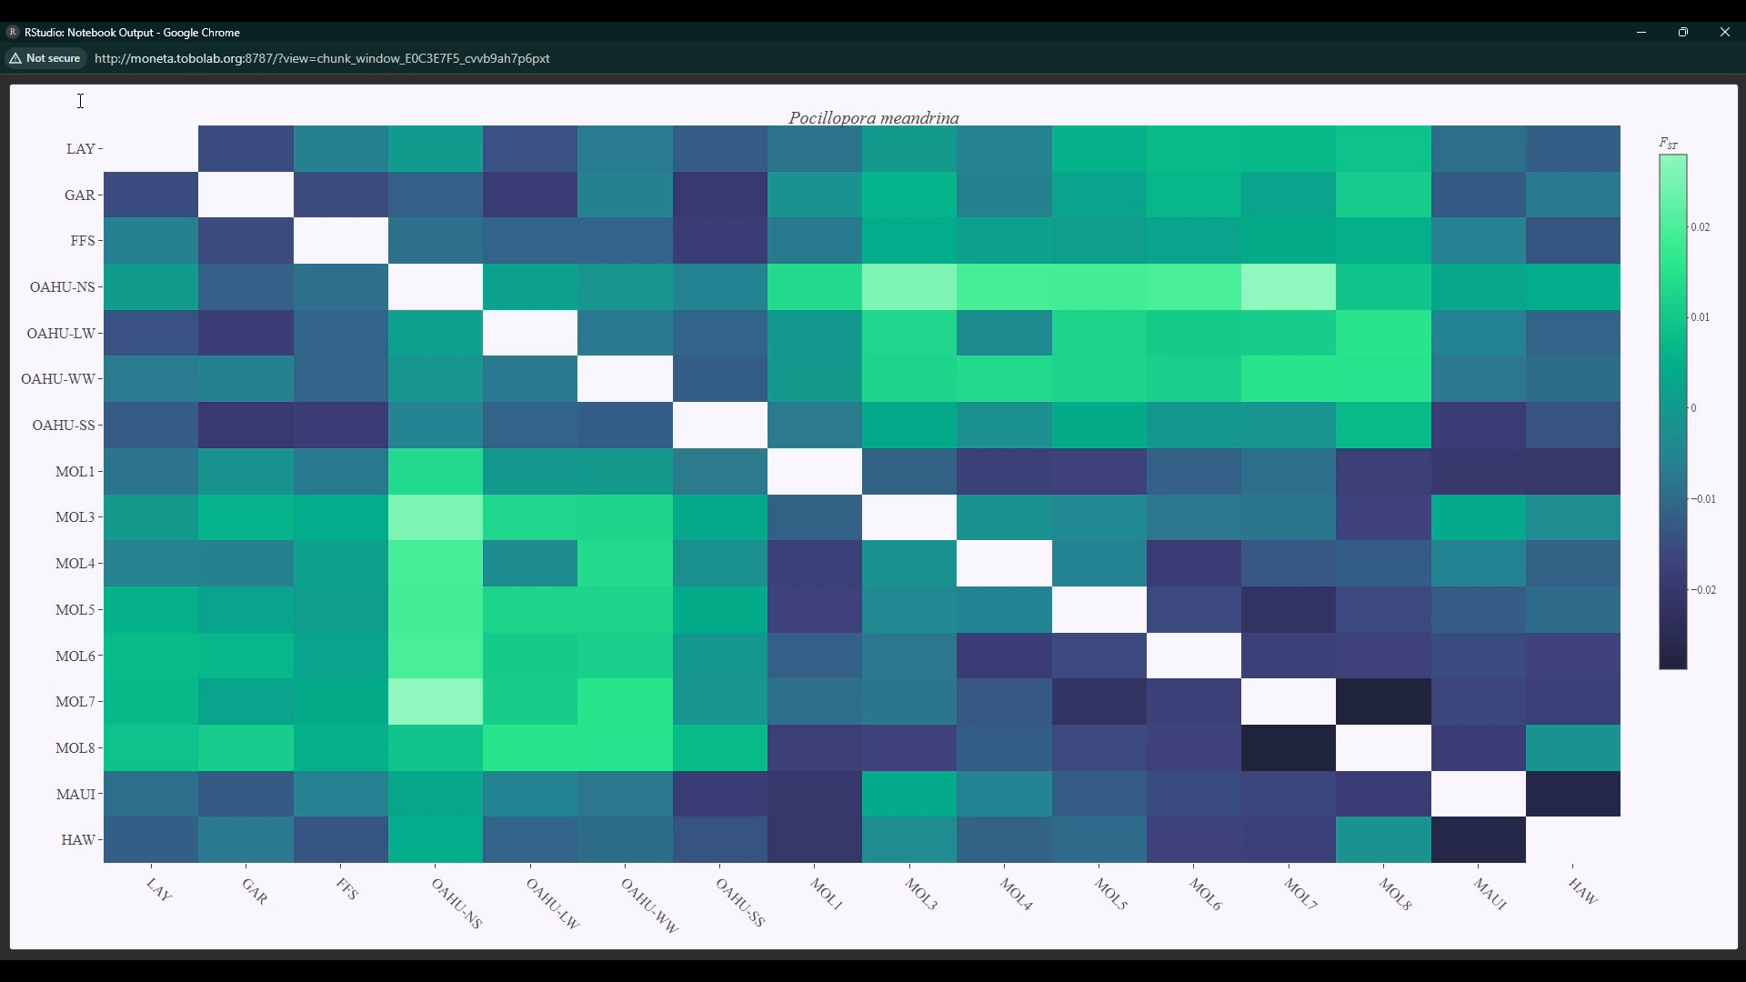
Heatmap
Population 1
Population 2
Notes:
The last plot I’d like to highlight is a pairwise heat map, which allows you to explore patterns of differentiation
Each pixel represents a pairwise comparison between two populations, the lighter the color the more genetically distinct the populations are.

Slide 43
Demo Time!
Notes:
From this chapter, we have a tangible tool to aide in the analysis of pool-seq data
So far its been used in 3 completed dissertations, from two universities, with three associated publications

Slide 44
Download assessPool
git clone https://github.com/ToBoDev/assessPool.git

Slide 45

Example Data
https://storage.tobolab.org:5001/sharing/zLejc1LG7
https://drive.google.com/drive/folders/1eqnjDrF0swog4UgqsstfnOja0LOZOL_i?usp=sharing

Slide 46
Prep
#suggested file structure
# project
# |____raw
# | |____library_1
# | |____library_2
# | |____library_3
# | |____...
# |____trimming
# |____assembly
# |____quast
# |____mapping
# |____...
File Structure

Slide 47
Prep
NUMPROC=50
MEMORY=500
PROJ=${PWD##*/}
if [ ! -d "trimming" ]; then mkdir trimming; fi
if [ ! -d "trimming/fqc_out" ]; then mkdir trimming/fqc_out; fi
if [ ! -d "assembly" ]; then mkdir assembly; fi
if [ ! -d "quast" ]; then mkdir quast; fi
if [ ! -d "mapping" ]; then mkdir mapping; fi
if [ ! -d "mapping/logs" ]; then mkdir mapping/logs; fi
if [ ! -d "variantcalling" ]; then mkdir variantcalling; fi
if [ ! -d "variantcalling/logs" ]; then mkdir variantcalling/logs; fi
File Structure

Slide 48
Trimming
if test -n "$(find ./raw -maxdepth 1 -name '*R2*' -print -quit)"; then
parallel -j $NUMPROC trim_galore --paired --illumina --fastqc -o trimming/ ::: ` find ./raw \( -name "*R1*.f*.gz" -o -name "*F.f*.gz" \) | sort ` :::+ ` find ./raw \( -name "*R2*.f*.gz" -o -name "*R.f*.gz" \) | sort `
find ./trimming -maxdepth 1 -name "*val_1*.gz" | sort | uniq > fwds
find ./trimming -maxdepth 1 -name "*val_2*.gz" | sort | uniq > revs
mv ./trimming/*fastqc* ./trimming/fqc_out/ ; mv ./trimming/*.txt ./trimming/fqc_out/
else
parallel -j $NUMPROC trim_galore --illumina --fastqc -o trimming/ ::: ` find ./raw -name "*R1*.f*.gz" `
mv ./*fastqc* ./fastqc/
fi
TrimGalore!

Slide 49
Assembly
if test -n "$(find ./raw -maxdepth 1 -name '*R2*' -print -quit)"; then
echo reverse reads found. proceeding with paired end assembly
#setspades.R
[EXTRA CODE TO WRITE Rscript for YAML]
chmod 755 spades_yaml.R
Rscript spades_yaml.R
#paired-end assembly
spades.py --dataset libraries.yaml -k 71,81,91,99,121,127 -t $NUMPROC -m $MEMORY -o ./assembly/${PROJ}_usr_kmer/
spades.py --dataset libraries.yaml -t $NUMPROC -m $MEMORY -o ./assembly/${PROJ}_default_kmer/
SPAdes

Slide 50

Assembly QC
parallel -j $NUMPROC cp ./assembly/{}/contigs.fasta ./quast/{}_contigs.fasta ::: \
` find ./assembly -maxdepth 1 -type d | sort | uniq | cut -d "/" -f3 `
all_default=(` find ./quast/*contigs.fasta -type f `)
quast.py --large -e -k -t $NUMPROC -m $MEMORY "${all_default[@]}" -o ./quast/default_spades/

Slide 51
Mapping
for i in `find ./quast/ -maxdepth 1 -name "*fasta" -type f` ; do
sed ':a;N;/^>/M!s/\n//;ta;P;D' ${i} | awk '/^>/ { getline seq } length(seq) > 2000 { print $0 "\n" seq }' - > ${i/_kmer_contigs.fasta/}_large.fa
done
parallel -j $NUMPROC bwa index {} ::: \
` find ./mapping ./trimming -name "*.fasta" -o -name "*.fq.gz" `
#` find ./trimming ./mapping -name "*.f*.gz" -o -name "*.fasta" `
bwa

Slide 52
Mapping
#PAIRED
parallel -j "$(( ${#LIBS[@]} / ($SPLITS * 2) ))" \
"bwa mem ./mapping/${PROJ}_reference.fasta {1} {2} "\
"-L 20,5 -t $(( $NUMPROC / $((${#LIBS[@]} / ($SPLITS * 2))) )) "\
"-M -T 35 -A $optA -B $optB -O $optO -R "\
" \"@RG\\tID:{3}\\tSM:{3}\\tPL:Illumina\" 2> ./mapping/logs/bwa.{3}.log "\
" | mawk '\$6 !~/[2-9].[SH]/ && \$6 !~ /[1-9][0-9].[SH]/' "\
" | samtools view -@ $(( $NUMPROC / $SPLITS )) -q 1 -SbT ./mapping/${PROJ}_reference.fasta - > ./mapping/{3}.bam 2> ./mapping/logs/{3}.bwa.log" ::: \
` find ./trimming -name "*val_1*.f*.gz" | sort ` :::+ \
` find ./trimming -name "*val_2*.f*.gz" | sort ` :::+ \
` find ./trimming -name "*val_1*.f*.gz" | sort | cut -d "/" -f3 | cut -d "_" -f1 `
parallel -j "$(( ${#LIBS[@]} / ($SPLITS * 4) ))" samtools sort -@ "$(( $NUMPROC / $((${#LIBS[@]} / ($SPLITS * 4))) ))" -O BAM -o {.}.sort.bam {.}.bam ::: \
` find ./mapping -name "*.bam" -not -name "*sort*" | sort `
bwa

Slide 53
Variant Calling
parallel -j $NUMPROC samtools index {} ::: ` find ./mapping -name "*.sort.bam" `
find ./mapping -name "*.sort.bam" > ./variantcalling/bams.list
samtools merge -@ $NUMPROC -b ./variantcalling/bams.list -f ./variantcalling/merged_pools.bam
samtools index ./variantcalling/merged_pools.bam
samtools faidx ./mapping/${PROJ}_reference.fasta
Freebayes

Slide 54
Variant Calling
parallel -j $NUMPROC samtools index {} ::: ` find ./mapping -name "*.sort.bam" `
find ./mapping -name "*.sort.bam" > ./variantcalling/bams.list
samtools merge -@ $NUMPROC -b ./variantcalling/bams.list -f ./variantcalling/merged_pools.bam
samtools index ./variantcalling/merged_pools.bam
samtools faidx ./mapping/${PROJ}_reference.fasta
Freebayes

Slide 55
Variant Calling
POPS=(` find ./trimming -name "*val_1*.f*.gz" | sort | cut -d "/" -f3 | cut -d "_" -f1 | sort | uniq `)
bamToBed -i ./variantcalling/merged_pools.bam | bedtools merge -i - > ./variantcalling/mapped.bed
bedtools coverage -b ./variantcalling/merged_pools.bam -a ./variantcalling/mapped.bed -counts -sorted > ./variantcalling/cov.stats
DP=$(mawk '{print $4}' ./variantcalling/cov.stats | sort -rn | perl -e '$d=.001;@l=<>;print $l[int($d*@l)]')
CC=$( mawk -v x=$DP '$4 < x' ./variantcalling/cov.stats | mawk '{len=$3-$2;lc=len*$4;tl=tl+lc} END {OFMT = "%.0f";print tl/"'$(( $NUMPROC * 2 ))'"}')
find ./trimming/ -name "*.fq.gz" | cat | parallel -j $NUMPROC "gunzip -c {} | head -2 | tail -1 >> ./variantcalling/lengths.txt"
MaxLen=$(mawk '{ print length() | "sort -rn" }' ./variantcalling/lengths.txt | head -1)
MaxLen2=$(( $MaxLen / 2 ))
ML1=$(( $MaxLen2 + 1 ))
MaxCov=$(mawk '{print $4}' ./variantcalling/cov.stats | sort -rn | head -1)
MaxCov2=$(( $MaxCov * 8 / 10 ))
Freebayes

Slide 56
Variant Calling
mawk '$4 > $MaxCov2' ./variantcalling/cov.stats > ./variantcalling/cov.high.stats
mawk '$4 <= $MaxCov2' ./variantcalling/cov.stats > ./variantcalling/cov.low.stats
bedtools makewindows -b ./variantcalling/cov.high.stats -w $MaxLen2 -s $ML1 > ./variantcalling/temp1.bed
bedtools intersect -a ./variantcalling/cov.stats -b ./variantcalling/temp1.bed > ./variantcalling/temp.cov.stats
cat ./variantcalling/temp.cov.stats ./variantcalling/cov.low.stats > ./variantcalling/cov.split.stats
rm ./variantcalling/cov.high.stats ./variantcalling/cov.low.stats ./variantcalling/temp1.bed ./variantcalling/temp.cov.stats
TT=$(( $MaxLen2 * 1000000 ))
Freebayes

Slide 57
Variant Calling
mawk -v x=$DP '$4 < x' ./variantcalling/cov.split.stats |sort -V -k1,1 -k2,2 | mawk -v cutoff=$CC -v tt=$TT 'BEGIN{i=1}
{len=$3-$2;lc=len*$4;cov = cov + lc
if (NR == 1 && lc > tt) {x="./variantcalling/mapped."i".bed";print $1"\t"$2"\t"$3 > x; i=i+1; e=1}
else if ( cov < cutoff && lc < tt) {x="./variantcalling/mapped."i".bed";print $1"\t"$2"\t"$3 > x; e=0}
else if (lc > tt && e > 0 ) {x="./variantcalling/mapped."i".bed"; print $1"\t"$2"\t"$3 > x; cov=0;i=i+1; e=1}
else if (lc > tt && e < 1 ) {i=i+1; x="./variantcalling/mapped."i".bed"; print $1"\t"$2"\t"$3 > x; cov=0;i=i+1;e=1}
else if (cov > cutoff && lc < tt ) {i=i+1; x="./variantcalling/mapped."i".bed"; print $1"\t"$2"\t"$3 > x; cov=lc;e=0}
}'
wait
Freebayes

Slide 58
Variant Calling
call_genos(){
if [ ! -f "./variantcalling/split.$1.bam" ]
then samtools view -b -1 -L ./variantcalling/mapped.$1.bed -o ./variantcalling/split.$1.bam ./variantcalling/merged_pools.bam
fi
samtools index ./variantcalling/split.$1.bam;
freebayes -b ./variantcalling/split.$1.bam -t ./variantcalling/mapped.$1.bed \
-f ./variantcalling/reference.fasta \
[FREEBAYES PARAMETERS] \
./variantcalling/raw/raw.$1.vcf
/10tb_leviathan/evan/assesspool_dev/scripts/vcflib/bin/vcffilter -f \
[FILTERING PARAMETERS] \ " ./variantcalling/raw/raw.$1.vcf | \
vcftools --vcf - \
[FILTERING PARAMETERS] \
--recode --recode-INFO-all \
--stdout > ./variantcalling/filtered/filtered.$1.vcf
}
export -f call_genos
ulimit -s unlimited
ls ./variantcalling/mapped.*.bed | sed 's/mapped.//g' | sed 's/.bed//g' | cut -d "/" -f3 | shuf | parallel --env call_genos -j $NUMPROC --no-notice call_genos {}
Freebayes

